Slide 1
Digital Portfolio
STUDENT NAME: K. Siva
REGISTER NO AND NMID: 20924U18165 D4780A43BDD66B2BAD94CBAFCE4B7027
DEPARTMENT: B. Se. Cs
COLLEGE: COLLEGE/ UNIVERSITY: Shanmuga industries arts and science college/Thivalluvar University

Slide 2
PROJECT TITLE
"My Portfolio"

Slide 3


AGENDA
Problem Statement
Project Overview
End Users
Tools and Technologies
Portfolio design and Layout
Features and Functionality
Results and Screenshots
Conclusion
Github Link
3/21/2024 Annual Review

Slide 4

PROBLEM STATEMENT
Create a personal online portfolio to showcase skills, projects, and contact information for web development opportunities.

Slide 5

PROJECT OVERVIEW
A responsive portfolio website presenting the developer's skills, projects, and contact details using HTML, CSS, and JavaScript.

Slide 6

WHO ARE THE END USERS?
Potential employers, clients, and anyone interested in the developer's work.

Slide 7

TOOLS AND TECHNIQUES
HTML CSS JavaScript

Slide 8
POTFOLIO DESIGN AND LAYOUT
Simple, clean design with a header, navigation menu, about section, projects grid, contact section, and footer.
8

Slide 9
FEATURES AND FUNCTIONALITY
Responsive project grid Navigation links Interactive button with JavaScript alert Simple styling and hover effects

Slide 10
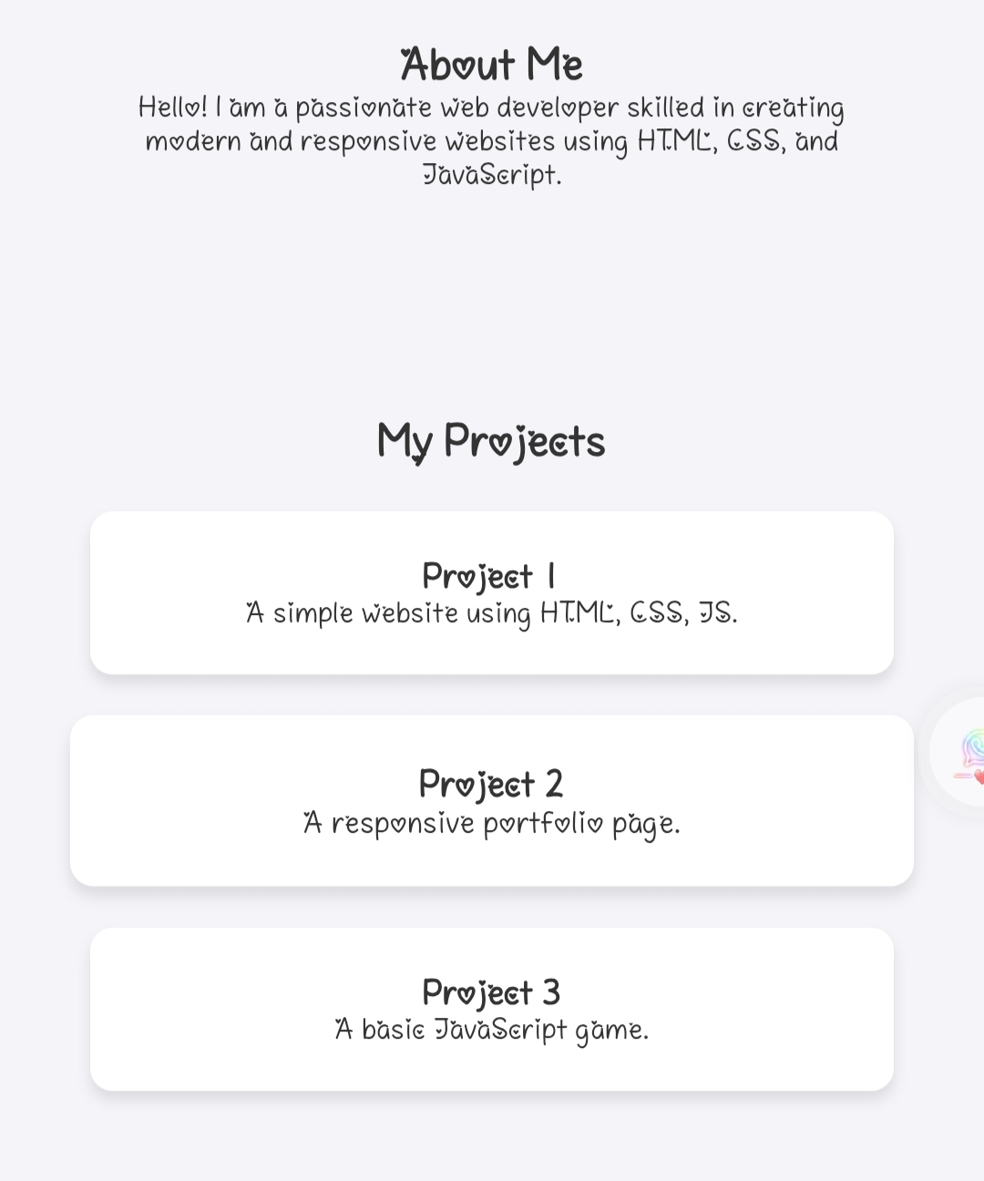
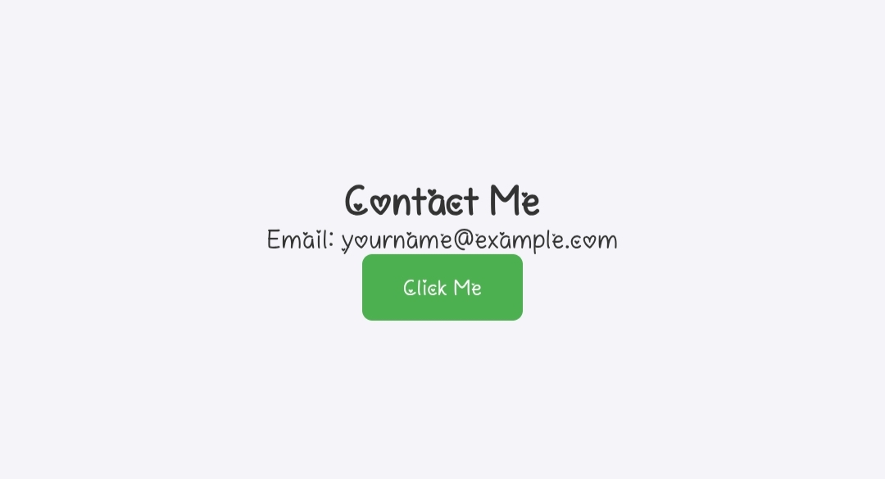

RESULTS AND SCREENSHOTS
3/21/2024 Annual Review
10

Slide 11
CONCLUSION
A basic, functional portfolio to present web development skills and projects in a professional and responsive format.
11

